Slide 1
Programming with Python 🐍
Workshop Session

Slide 2
What is python?
Python is named after Monty Python
It is a programming language
Developers can use it for almost anything…
Creating websites
Analyzing large data sets – making A.I.
Controlling robots
Designing video games
Many other things!
Notes:
Ask students if they know anything about Python or programming. Ask them to guess how Python got its name. Ask them if they know what a general-purpose language is.

Slide 3
What does python code look like?

Slide 4
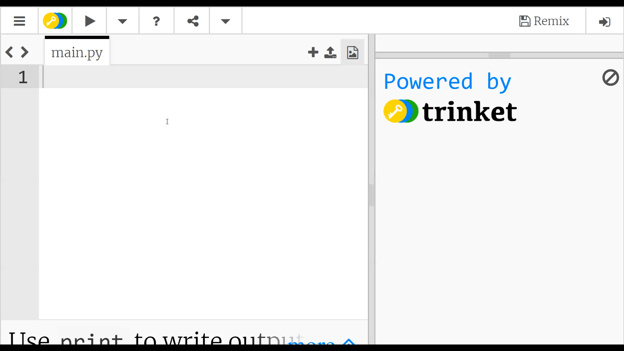
Notes:
Show an example of a print message

Slide 5
What are these?
“ ”
“Quotes” or “Quotation Marks”
In Python, these go around text
Those pieces of text are called strings
Notes:
Ask the students to type out a command that would print a message of “Welcome” instead. Then reveal the answer.

Slide 6
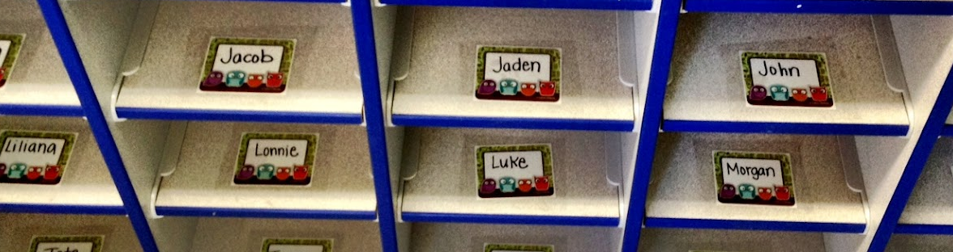
What are these?
Cubbies! Cubbies are containers for things
In computer science, variables are containers for things
Variables can contain things like strings
Notes:
Ask the students if they know what the image is – mailbox/cubbyholes.
Explain that variables in computer science are kind of like this – they are containers for data.
This may not make much sense yet, but this example can be used to make variables a little more tangible. Setting a variable is like putting something into a cubbyhole, and using its value is like looking into the cubbyhole.

Slide 7
Variables – Python Example
person = "Sam"
print("Hello " + person)
What message will the user see?
Hello Sam
Notes:
Ask the students if they can guess what this does. Then reveal the answer.
Note that variable names must have no spaces, no special characters

Slide 8
Variables – Python Example
person = "Sam"
print("Hello " + person)
The variable here is named person. The code sets the value of the variable, and then references it.
Variable names can only have letters – no spaces or special characters!
Notes:
Explain this example in terms of cubbyholes – my_name is like the name on the mailbox, and my_name = “Sam” is like putting some mail in the mailbox. Then, using the variable is like peeking into the mailbox to see what’s in there.

Slide 9
Repeating code with Loops
Developers want to write as little code as possible!
Rather than copying and pasting code, developers use loops
Loops allow programs to repeat the same lines of code a number of times
This way, instead of writing 500 lines of code, the same can be accomplished in just a few lines
It is much easier to maintain!
Notes:
This slide is mostly for informational purposes, and the students will likely be distracted by the looping gif, so it is not necessary to stay very long on this slide.
Explain loops in the context of the image; rather than having to hand-animate every single repeated frame, the gif will loop forever, which is much easier!

Slide 10
Important for loops: This symbol
What is this symbol called?
:
colon
Notes:
This slide is mostly for informational purposes, and the students will likely be distracted by the looping gif, so it is not necessary to stay very long on this slide.
Explain loops in the context of the image; rather than having to hand-animate every single repeated frame, the gif will loop forever, which is much easier!

Slide 11
Loops – Python Example
for x in range(10):
print("| || |")
What will this code do? How many times?
Notes:
See if the students can figure out what this code does. The for loop syntax is not incredibly important, as it will be the same every time (other than the number of iterations). Allow the students to type this code into trinket to see what it does.

Slide 12
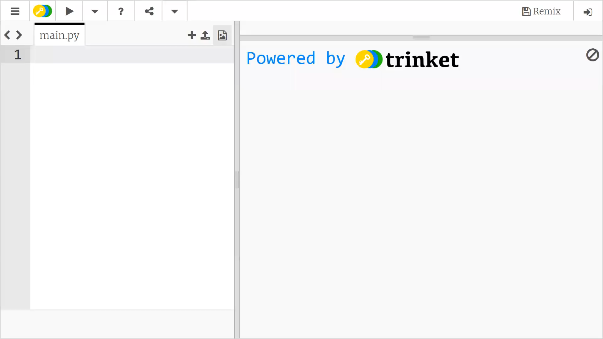

Slide 13
Loops – Python Example
print("| || |")
This line simply prints out a message
Note the indentation – this means it is within a loop
for x in range(10):
This line tells the program to repeat 10 times
Repeating the message makes a picture of a road!
Notes:
Explain what the example code does. Emphasize the need for indentation.
Printing a message is simple enough; it just prints the message to the screen.
The print code is within the for code (under it, and indented). The for x in range(): will always be the same for them, the only thing they’ll change is the number.

Slide 14
Challenge – Make a longer road
How could you update the existing loop to make a longer road?
for x in range(10):
print("| || |")
for x in range(20):
print("| || |")
Notes:
Give students the opportunity to try and change the code so it prints more messages. All they have to do is change 10 to 20 (or another number higher than 10) so it prints more.

Slide 15
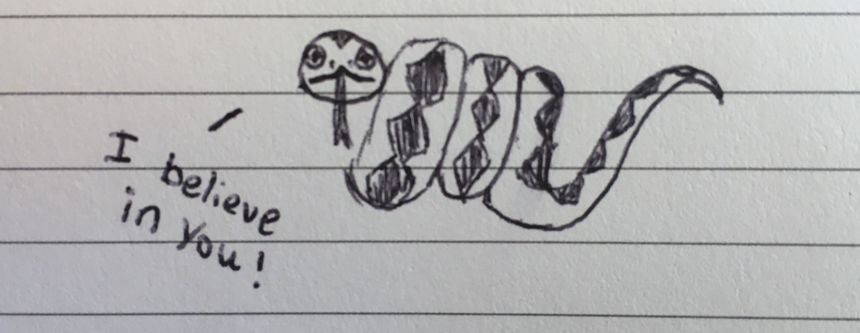
Summary and Closing Remarks
Python can be used to make things like games and A.I.
Strings go between quotes
Variables are containers for things like strings
Loops will repeat certain lines of code multiple times
This programming can feel intimidating – but don’t worry
You can do it!
Notes:
The main point of this slide is to try encourage students. They may feel overwhelmed because this is a lot of information – but they should stick with it and know that they can learn if they put their mind to it!

Slide 16
Questions?

Slide 17
ACTIVITY TIME!
bit.ly/coding-activities
Click on Python
Click the link to Trinket

